Slide 1
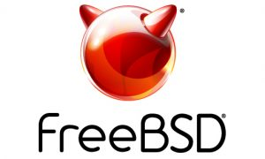

FreeBSD server
Bill Anderson
“BSD Daemon”
aka “Beastie”

Slide 2
What is BSD?
Berkley Software Distribution
(aka Berkley Standard Distribution)
UC-Berkley offshoot of the original Research Unix from AT&T Bell Labs
First released March 9th, 1978

Slide 3
What is BSD?
Original BSD was last released June 1995
Modern open-source offshoots
NetBSD (April 1993 – First open-source BSD)
FreeBSD (November 1993 – Most popular stand-alone BSD today)
OpenBSD (July 1996 – Security-focused fork of NetBSD)
DragonFly BSD (July 2004 – Multi-process-focused fork of FreeBSD)
Darwin (November 2000 – By Apple, is the foundation for OSX/macOS and iOS)
TrueOS, FreeNAS, GhostBSD, TrueNAS/OpenNAS, …and many others!

Slide 4








BSDs (and code from BSDs) used in:
Apple OS’s (Apple also heavily borrows code from FreeBSD and others)
Windows TCP/IP stack (discontinued…?)
Apache Software Foundation servers
PlayStation 3, 4, and 5
Nintendo Switch
NetFlix
Cisco
Microsoft Azure
VMWare
pfSense (firewall)
Many others!!!!

Slide 5

Linux vs BSDs

Slide 6
Linux vs BSDs
GNU license (“copyleft”)
Kernel ONLY
Most distros not POSIX compliant
Wide variation in distros
Trendy & cool, More familiarity
More customizable
More software options available
BSD license (doesn’t require that re-used code remain open-source)
Entire OS as a whole package
Mostly POSIX compliant (not certified)
Relatively standardized with other BSDs
Highly stable, highly predictable
More secure. More efficient networking stack
Most software packages only available as “ports”

Slide 7
Linux vs BSDs Commonalities
Unix Derivatives
Written primarily in C
Share many shell commands and packages
Open-source. Maintained by a community of developers
Linux is a larger & less organized community, and ostensibly led by a single personality, Linus Torvalds
BSD communities are smaller & tighter-knit, without a “cult of personality”
Used in a wide variety of situations, from Web Servers to IOT/embedded systems to desktop PCs

Slide 8
FreeBSD “Jails”
Lightweight virtualization
“Containerization” similar to Docker (or AWS Lambda?)
Implemented at the Kernel level
First introduced in FreeBSD 4.0, released March 2000
Comparison: Docker released March 2013 (!!!)
Built on “chroot” environment

Slide 9
Why “Jails”?
SECURITY
Most services run (in-part) with root privileges (!!!)
If one app or service is compromised, a “jail” prevents attackers from comprimising other apps/services
Principle of least privilege

Slide 10
“Thin Jails”
A “Thin Jails” system reuses the same core OS files for every jail.
The master filesystem is mounted to the root (“chroot”) directory of each jail, as a read-only mount. It becomes the root filesystem of the jail
This called a “nullfs” mount – the FreeBSD equivalent of Linux’s “bind” mount.
We are not mounting a physical device like an external hard drive or DVD/CD-ROM. We are just mounting one directory to another location in the filesystem.
The writable parts of the jail’s filesystem (which are unique to each jail) are then mounted on top of this read-only skeleton

Slide 11

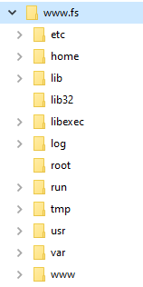
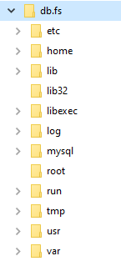
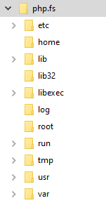
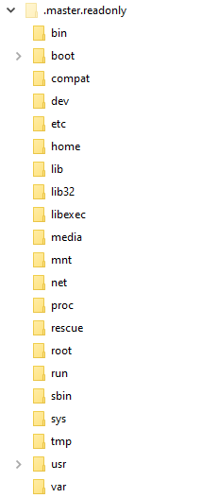
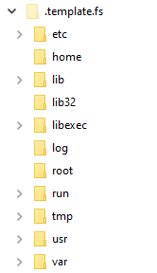
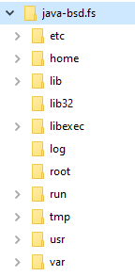
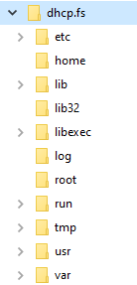
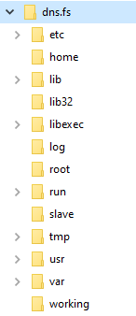
Master
Filesystem
READ-ONLY!
Template
Writable
Filesystem
Some of these …
are just empty mount points for those
I make a copy of the writable template filesystem for each jail. It is then customized based on the jail’s specific needs

Slide 12
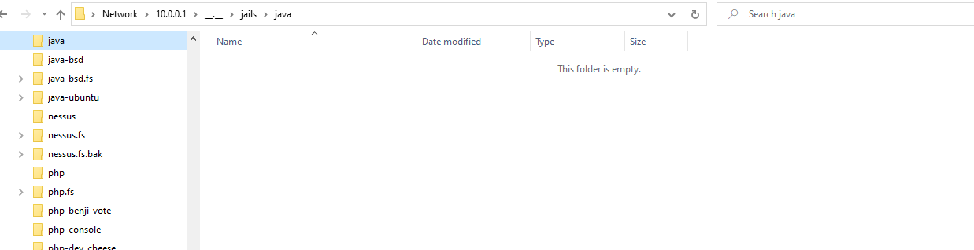
“Thin Jails”
When the jail is not active, its “chroot” directory is completely empty!
This folder is just a mount-point for the read-only root filesystem

Slide 13
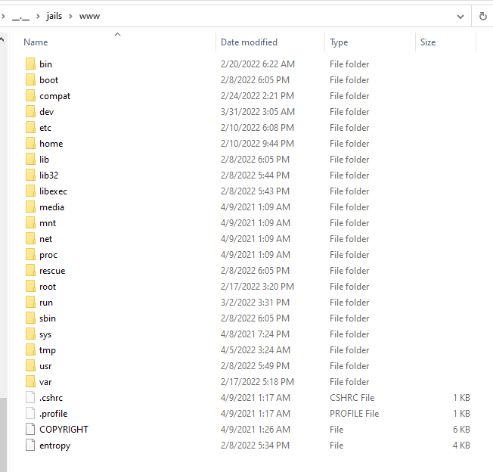
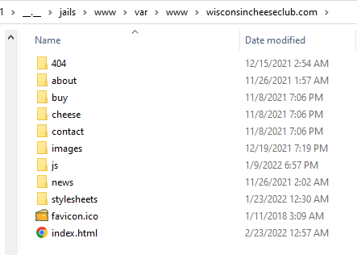
“Thin Jails”
When the jail is started, the read-only root filesystem is the first thing mounted.
Then the writable filesystem is mounted at specific mount-points on top of that. These mounts will vary depending on the jail

Slide 14
Interactions between jails
It is sometimes necessary for jails to interact with each other.
For example, the Java and PHP jails need to interact with the Database jail
The web server jail needs to interact with Java and PHP in order to send them requests and forward their responses
This is accomplished one of two ways:
Loopback interface (lo0 , aka localhost or 127.0.0.0/8)
Unix sockets!!

Slide 15
Interactions between jails: Unix Sockets!
A Unix socket is just a file (…like everything in the Unix world) that allows other processes to communicate with the process which owns the socket
Typically located in /var/run/service-name/service.sock (e.g. /var/run/mysql/mysql.sock)
Unix sockets require less overhead than the loopback interface. IP/TCP networking stack not needed!

Slide 16

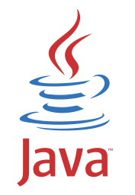

MOUNT IT!
Because the socket is a file in a dedicated folder, how can we allow another jail to access it?
Database Jail
/jails/db/var/run/mysql/mysql.sock
Java Jail
/jails/java/var/run/mysql/mysql.sock

Slide 17
